Slide 1
Nursing Theories
Developmental Nursing Theory

Slide 2
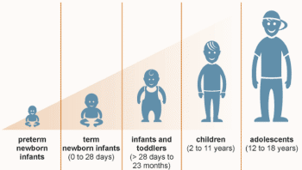
Overview
Growth and development of humans.
Behaviors of humans.
Genetic, emotional and physical factors.
Notes:
The theory highlights the development and development of individuals as predictable. It also shows the progress and behavioral characteristics of persons at each development stage. Human growth and development is determined by factors such as temperament, heredity, and their environments.

Slide 3
Examples
Gesselll’s theory of development.
Erikson’s theory of psychosocial development.
Freud’s pyschoanalytical model of personality development.
Kohlberg’s theory of moral development.
Piaget’s theory of cognitive development.
Notes:
Examples of developmental nursing theories include:
Gesselll’s theory of development.
Erikson’s theory of psychosocial development.
Freud’s pyschoanalytical model of personality development.
Kohlberg’s theory of moral development.
Piaget’s theory of cognitive development

Slide 4

Efficacy to in Nursing Practice
Promotes patient-centered care.
It equips nurses with relevant nursing skills and knowledge.
Enhanced professional status.
Improved communication.
Notes:
The theory ensure patient safety and quality care delivery. It also improves professional status of nursing practitioners since they are more knowledgeable and skilled. Lastly, it promotes communication among nurse due the availability of evidence-based information (Colley, 2003).

Slide 5
Proof of the Conceptual Model
Framework for describing, examining, and appreciating.
Significance of supporting human development.
Foundations of long-term relationships.
Assessment of response to certain diseases.
Notes:
It has a framework for describing, examining, and appreciating human development. It also demonstrates the significance of supporting human development and how it creates foundations for future relationships. Also, it helps assess peoples’ responses to certain diseases. Conceptual model of this theory aligns with the person adaptive system using repositories of knowledge of human development (Soussa & Hayman, 2002)

Slide 6

Four Meta-paradigm Concepts
Person.
Health.
Environment.
Nursing.
Notes:
Person: the theory emphasizes on the development of persons from infancy to adulthood. Health: It shows how the health of people deteriorate from birth up to death. Environment: It highlights that growth is determined by environmental factors. Nursing: It helps nurses prevent, predict, and identify variations within patients’ normal growth patterns.

Slide 7

Evidence-Based Examples: Baby’s Development
Comparison of a baby’s growth rate against the existing norms.
Aging of physical bodies.
Transition from infancy, adolescence, to adulthood.
Notes:
The growth of a baby can be compared with the existing norms to determine whether they are growing normally. In this regard, the aging and transition from childhood to adulthood can be monitored.

Slide 8
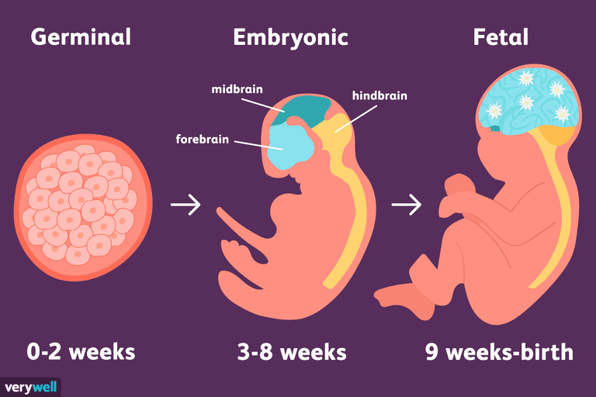
Sequential Development Example
Fetus development.
Cephalocaudal development.
Proximodistal development.
Notes:
Sequential development is witnessed in fetuses since it follows a fixed pattern that encompasses multiple organ systems. This examples align with the cephalocaudal pattern that shows that growth occurs from the top to the bottom. It also follows the proximodistal pattern that shows that growth starts at the center and move further sideways.

Slide 9

Responsiveness to the Environment Example
Differences in response to the environment.
Adult v. infant.
Infant v. infant.
Temperament.
Notes:
Adults and infants respond differently to the environment due to variations in emotional development. Temperament of adults and infants vary since they are at different stages of development. Also, different children respond to the environment depend on the conditions within their environment.

Slide 10

Cont.
Easygoing children.
Difficult children.
Slow children.
Notes:
Easygoing children are predictable and adaptable to changes in their environment. Difficult children are highly irritable and show irregularities in their behavioral characteristics. Slow children exhibit mild emotional intensity since they are resistant to changes in their environment.

Slide 11
Support and Rationale
Environmental factors.
Optimal growth.
Prediction and comparison of changes.
Unconscious and emotion-driven.
Notes:
The examples above shows that development sequence can be influenced by environmental factors. Optimal growth is only possible when the environmental conditions are favorable. Nurses can predict and compare changes in infants with predetermined development measurements. They also demonstrate that growth happen unconsciously and depend on emotional factors.

Slide 12
References
Colley, S. (2003) Nursing theory: its importance to practice. Nursing Standard, 17, 46, 33-37.
Soussa, D. V. & Hayman, L. L. (2002), Nursing theory development. Online Brazilian Journal of Nursing, 1(1), 2-9.

